Slide 1
Neuroscience
Cells, signals, systems, and brain networks
Takeaway: Neuroscience links behavior to brain and body processes without overclaiming what a diagram can prove.
Notes:
Instructor use
- This deck is takeaway-first and lecture mode: slides are anchors, explanation lives here in notes.
- Images are used for orientation and conceptual anchoring, not as proof of causation.
File setup
- Filenames match the uploads you shared.
Distribution safeguard
- If students will not receive speaker notes, publish a companion study note that includes the note content for each concept block.

Slide 2
How today is organized
Start with the big map of the nervous system
Add signal direction: afferent and efferent
Zoom in: neurons, glia, action potentials, synapses
Zoom out: autonomic regulation and brain structures
End with methods and limits
Takeaway: We will move from systems to cells to brain regions, then back to how we know what we know.
Notes:
Teaching note
- Keep repeating the organizing question: input, processing, output, regulation.
- Remind students that maps are simplifications used for learning and communication.

Slide 3
The nervous system map
Notes:
What is next
- A clean map of the central and peripheral nervous systems.
Why this matters
- Most confusion later comes from losing track of divisions and signal direction.

Slide 4
What the nervous system does
Detects information
Processes and integrates
Produces responses
Learns and adapts
Takeaway: The nervous system senses, decides, acts, and adapts.
Notes:
Example
- Touch a hot pan: sensory input, spinal processing, motor output, learning to avoid.
Common confusion
- The spinal cord and peripheral pathways also matter.
Transition
- Now anchor those functions to a system-level map.

Slide 5
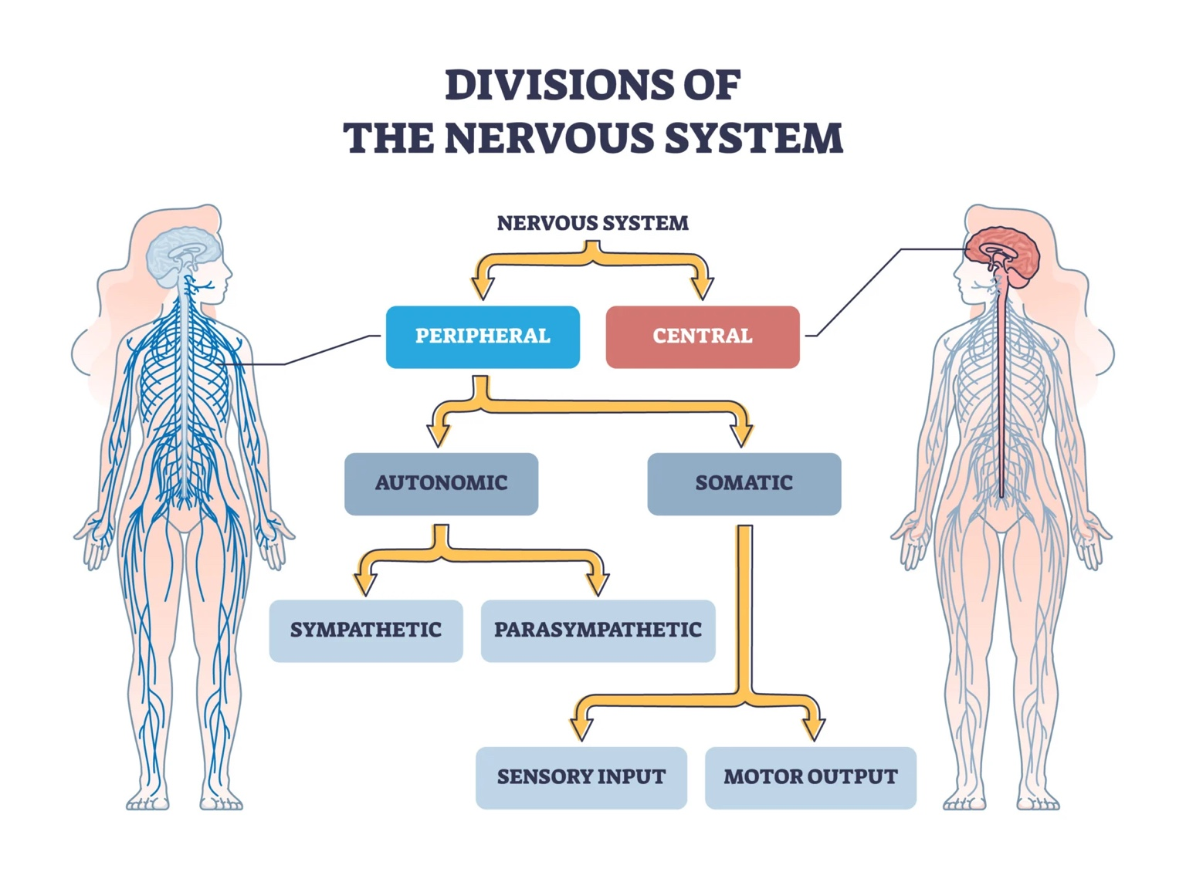
Divisions of the nervous system
Takeaway: Divisions help you locate where signals travel and what kinds of actions they control.
Notes:
Caption
- Hierarchical map of the nervous system.
Accuracy note
- Somatic includes voluntary movement and reflex loops.
- Autonomic is often automatic, but not fully beyond influence.
Transition
- Use a more student-friendly version next, then add signal direction.

Slide 6
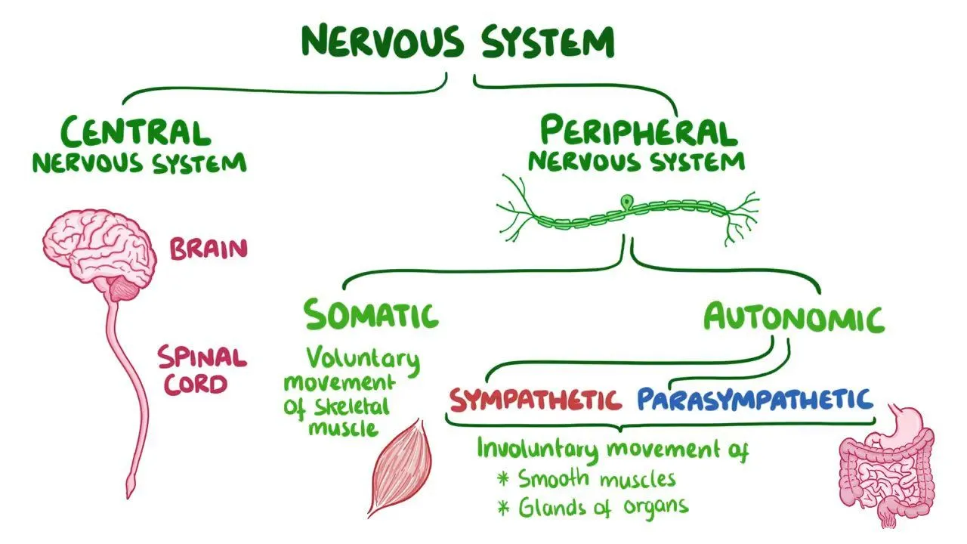
Nervous system map in plain language
Takeaway: CNS processes and integrates; PNS carries signals between CNS and body.
Notes:
Caption
- Student-friendly overview of CNS vs PNS and somatic vs autonomic.
Accuracy guardrails
- Autonomic is not a strict on-off switch.
- Somatic is not always voluntary.
Transition
- Add the direction layer: afferent and efferent.

Slide 7
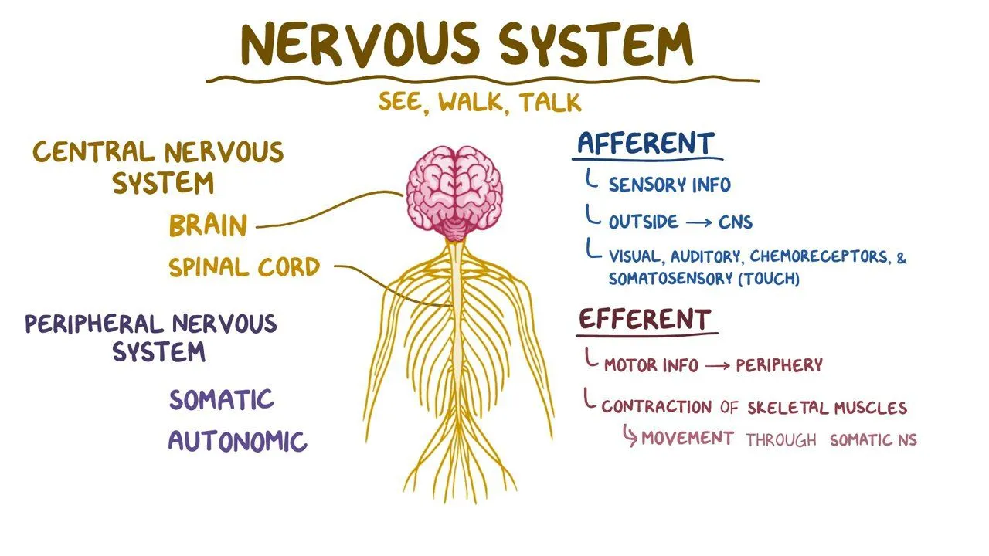
Afferent and efferent
Takeaway: Direction matters: afferent goes to the CNS, efferent goes to the body.
Notes:
Caption
- Afferent versus efferent as a direction label.
Accuracy guardrail
- Sensory input includes external senses and internal visceral sensory signals.
Transition
- Apply direction to a loop example.

Slide 8
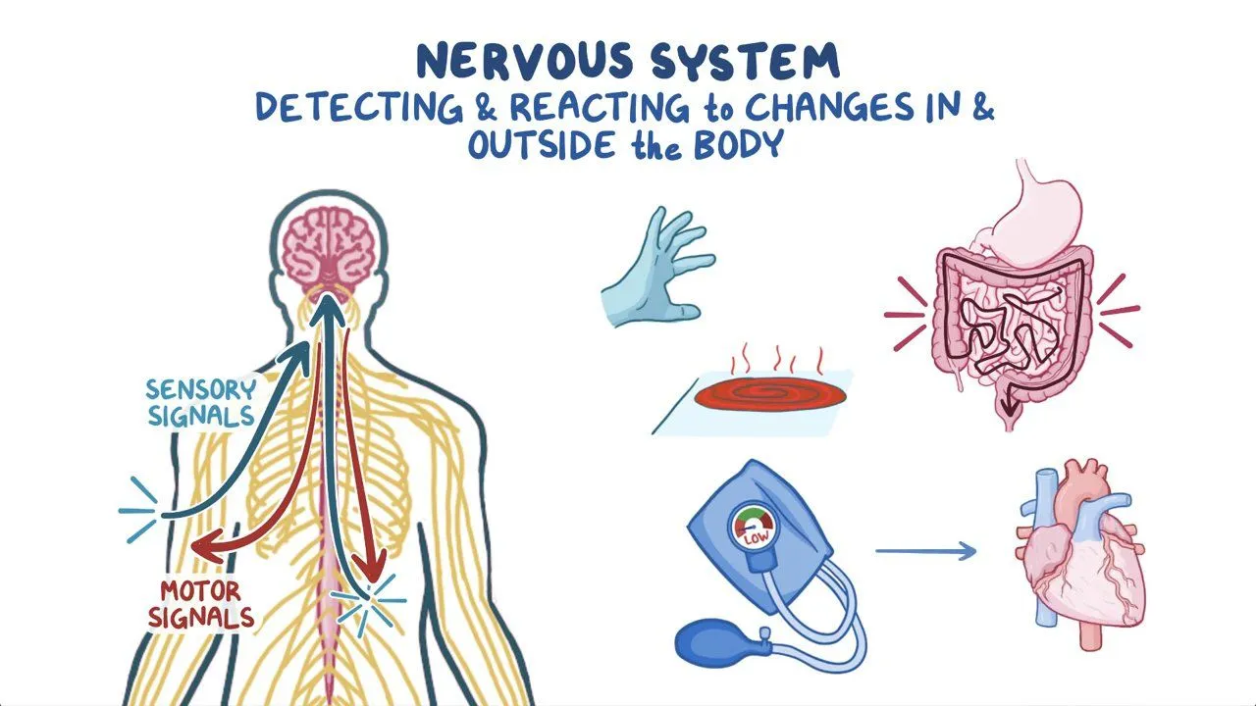
Sensory input and motor output loop
Takeaway: Behavior is a loop: input, processing, output, and ongoing adjustment.
Notes:
Teaching notes
- Choose one scenario: hot surface, withdraw, recovery.
- Name where processing happens: spinal cord for reflex, cortex for report.
Transition
- Engage: classify examples as afferent or efferent.

Slide 9
Engage: Afferent or efferent
Classify each as afferent or efferent:
Touching a hot mug and feeling heat
Pulling your hand away
Feeling your heart pounding
Sweating
Two minutes. Write four labels.
Takeaway: A strong answer labels direction correctly and can explain one example in plain language.
Notes:
Intended answers
- Afferent: feeling heat; feeling heart pounding.
- Efferent: pulling hand away; sweating.
Common wrong answers
- Calling sweating sensory because it is felt.
- Treating the terms as system names.
Debrief
- Ask for one explanation, not four.

Slide 10
Peripheral nervous system in detail
Notes:
What is next
- Somatic versus autonomic, then sympathetic versus parasympathetic.
Why this matters
- Used constantly for emotion, stress, and health.

Slide 11
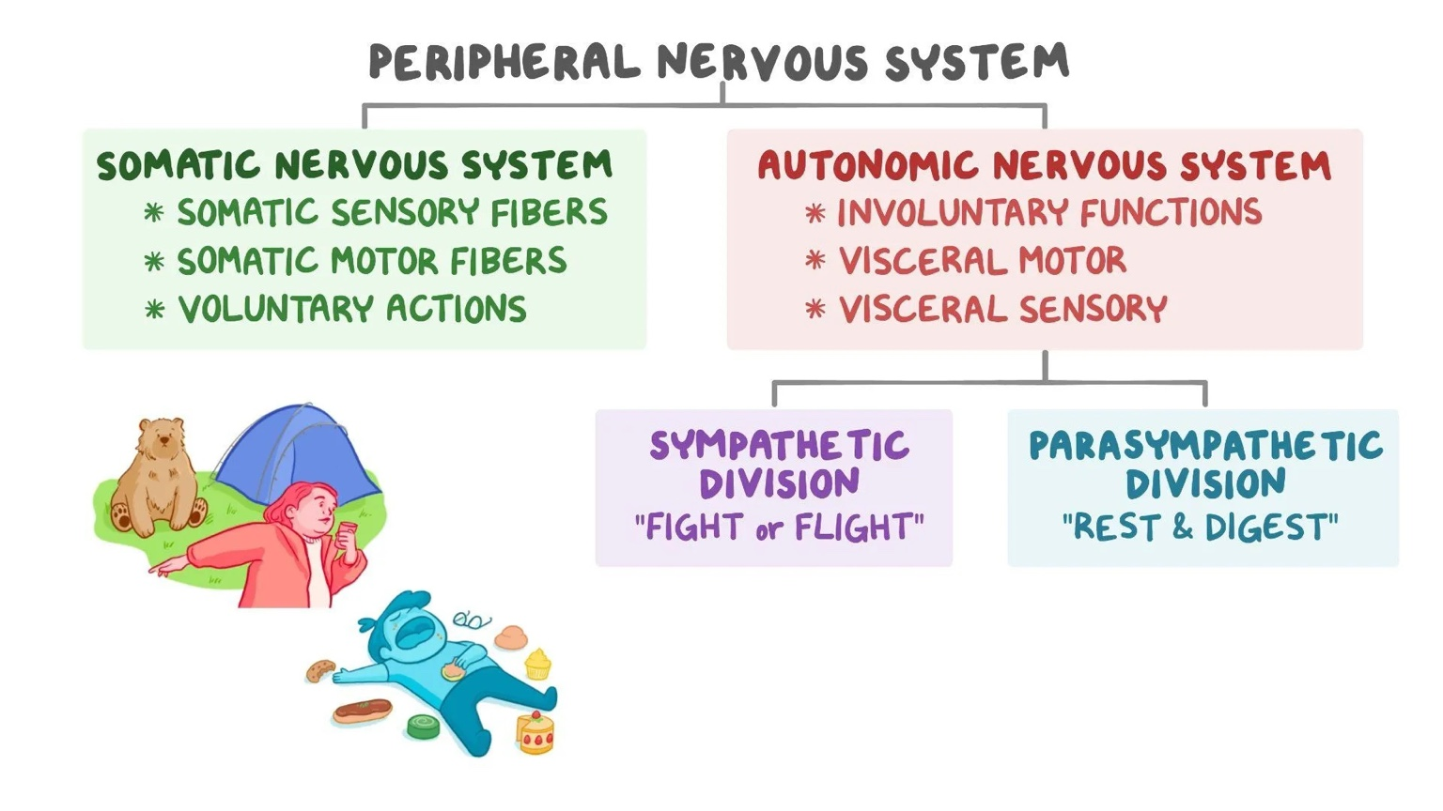
Somatic versus autonomic
Takeaway: The PNS carries signals through somatic pathways and autonomic regulation pathways.
Notes:
Accuracy guardrails
- Somatic includes reflexes.
- Autonomic is influenced by context and learning.
- Sympathetic and parasympathetic can co-occur.
Transition
- Move from the map to what the autonomic branches tend to do.

Slide 12
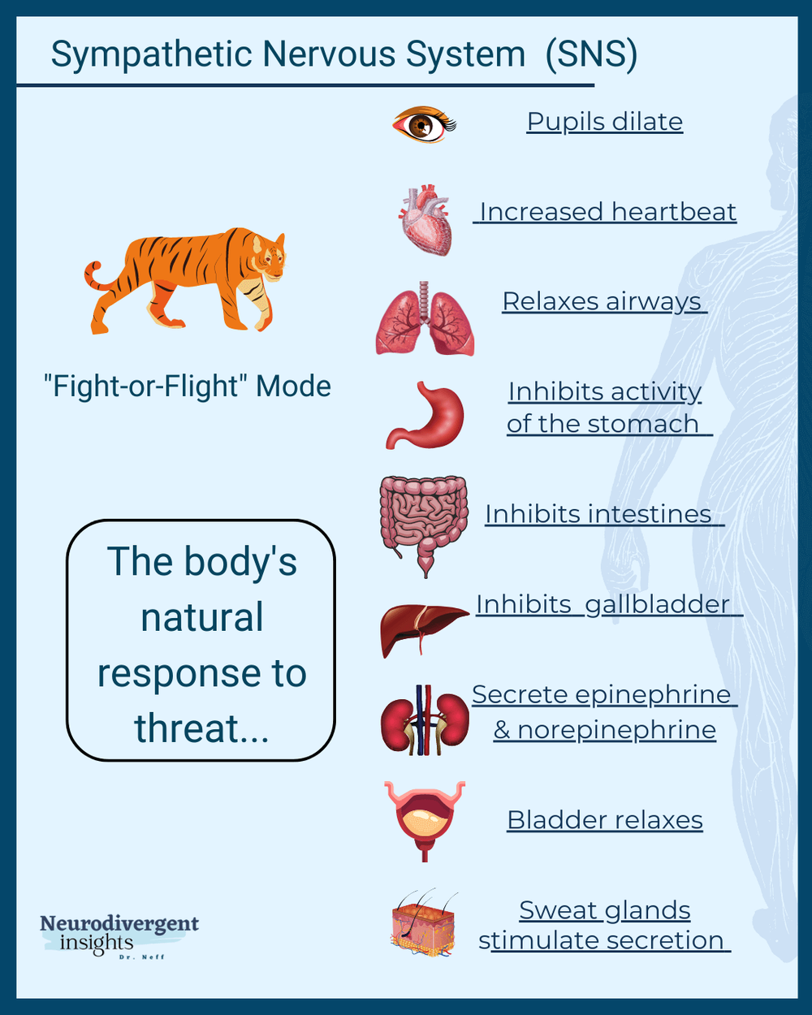
Sympathetic nervous system
Takeaway: Sympathetic activity supports rapid action by shifting resources toward immediate demands.
Notes:
Accuracy guardrail
- Avoid “sympathetic equals stress equals bad.” Emphasize flexibility.
Transition
- Pair with parasympathetic restoration.

Slide 13
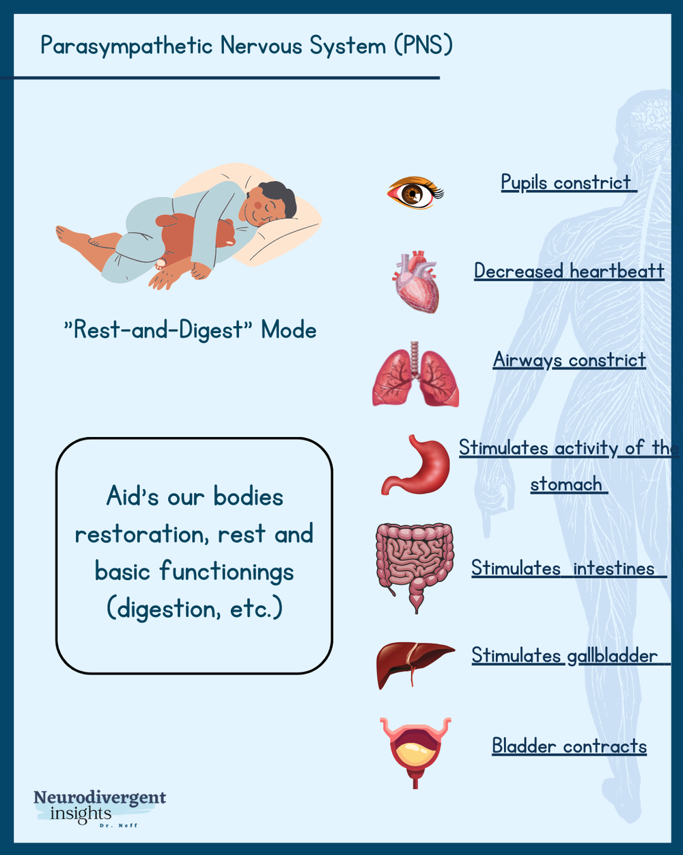
Parasympathetic nervous system
Takeaway: Parasympathetic activity supports restoration and digestion as demands pass.
Notes:
Accuracy guardrail
- Avoid a strict binary. Emphasize dynamic balance.
Transition
- Engage: apply to scenarios.

Slide 14
Engage: Which branch is more active
For each situation, name which branch is more active and why:
Sprinting to catch a bus
Eating a meal after a long day
Giving a speech
Falling asleep
Three minutes. Pair-share, then report one example.
Takeaway: A strong answer connects the scenario to a body goal, not to a slogan.
Notes:
Intended answers
- Sprinting and speech: sympathetic more active.
- Eating and sleep onset: parasympathetic more active.
Common wrong answers
- Treating “rest and digest” as meaning parasympathetic only happens during sleep.
- Treating “fight or flight” as meaning sympathetic only happens during danger.
Debrief
- Ask: what is the body trying to accomplish.

Slide 15
Cells and signaling
Notes:
What is next
- Neurons and glia, then electrical within neurons and chemical between neurons.
Why this matters
- Drugs, learning, and disorders depend on synapses and communication.

Slide 16
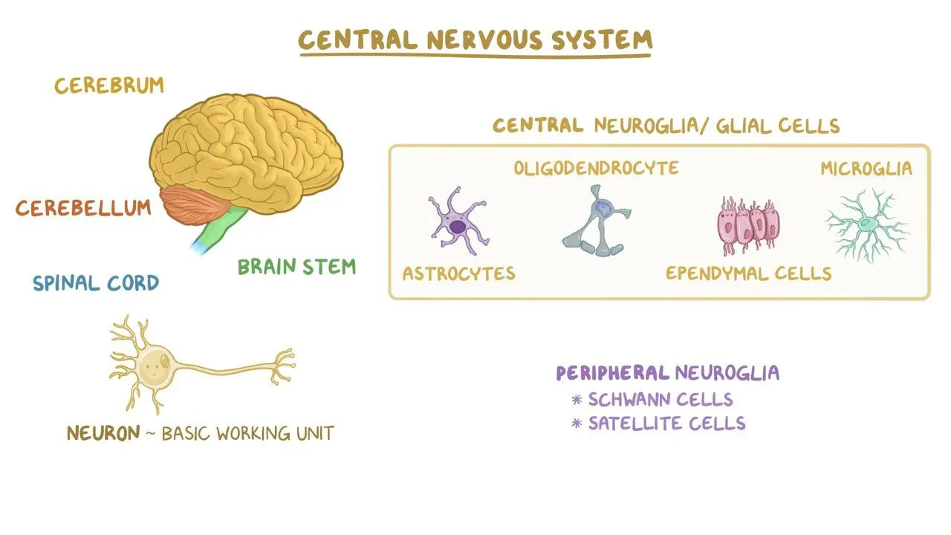
Neurons and glia
Takeaway: Glial cells are active partners in neural function, not passive filler.
Notes:
Key points
- Oligodendrocytes myelinate CNS axons; Schwann cells myelinate PNS axons.
- Microglia play immune-like roles in the CNS.
Transition
- Separate signal types: electrical within, chemical between.

Slide 17
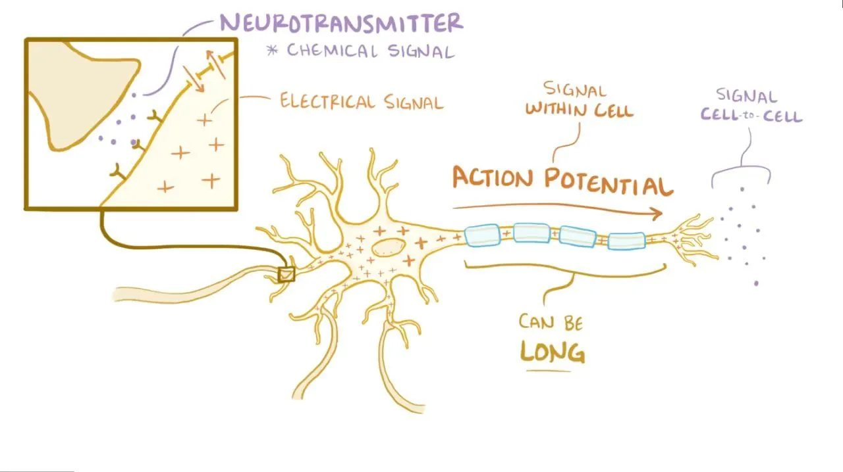
Electrical within neurons, chemical between neurons
Takeaway: Neural communication uses electrical signaling within cells and chemical signaling between cells.
Notes:
Teaching move
- Keep it conceptual here, then go detailed on synapses next.
Transition
- Show a detailed synapse and connect it to drug effects.

Slide 18
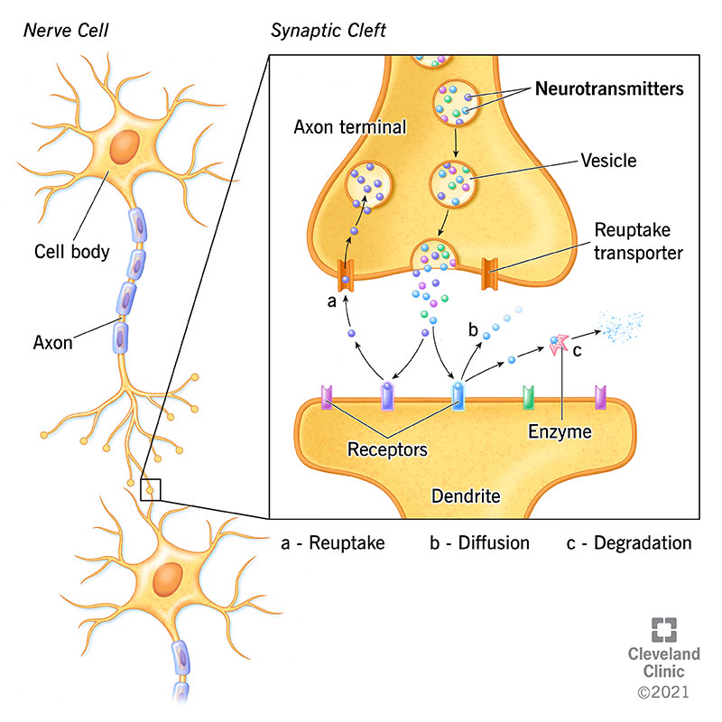
Synapse and neurotransmitter signaling
Takeaway: Synapses translate electrical signals into chemical signals and shape what happens next.
Notes:
Accuracy guardrail
- Neurotransmitters are not one-chemical equals one emotion.
- Effects depend on receptors, pathways, and context.
Transition
- Engage: connect a medication idea to synapse mechanisms.

Slide 19
Engage: Where would a drug act
A medication increases neurotransmitter levels in the synaptic cleft.
Which mechanism is most likely affected:
Reuptake
Breakdown by enzymes
Vesicle release
Two minutes. Vote, then write one sentence justification.
Takeaway: A strong answer names one mechanism and links it to neurotransmitter clearance.
Notes:
Intended answer
- Reuptake inhibition is common, but emphasize reasoning.
Common wrong answer
- Explaining it via action potentials rather than synaptic clearance.
Debrief
- Ask: how would changing clearance change receptor activation.

Slide 20
Brain regions and networks
Notes:
What is next
- Forebrain, midbrain, hindbrain; then landmarks, lobes, limbic structures.
Why this matters
- Students need network cautions from day one.

Slide 21
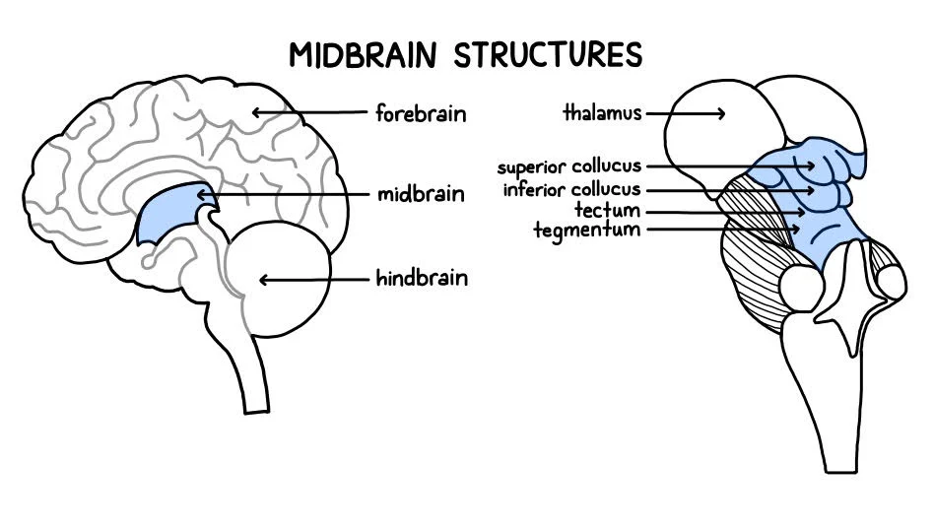
Forebrain, midbrain, hindbrain orientation
Takeaway: Brain regions are connected; labels help orientation, not perfect boundaries.
Notes:
Accuracy guardrail
- Thalamus is typically forebrain, not midbrain.
Transition
- Show forebrain structures, then contrast with hindbrain.

Slide 22
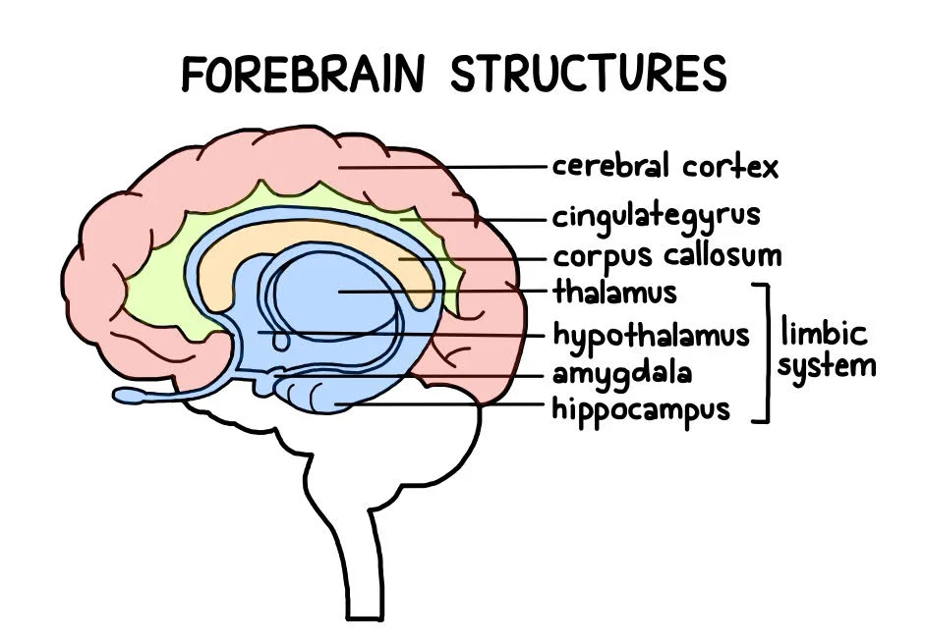
Forebrain structures
Takeaway: Forebrain structures support complex cognition and connect emotion, memory, and body regulation.
Notes:
Accuracy guardrail
- Limbic system is a convenient label, not a crisp anatomical unit.
Transition
- Contrast with hindbrain functions.

Slide 23
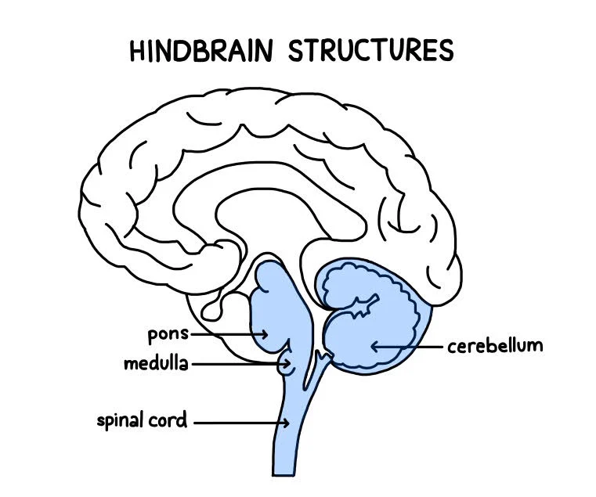
Hindbrain structures
Takeaway: Hindbrain structures support vital functions and coordinated movement.
Notes:
Teaching notes
- Brainstem: breathing, heart rate, arousal.
- Cerebellum: coordination, timing, error correction.
Transition
- Shift to cortex landmarks and lobes.

Slide 24
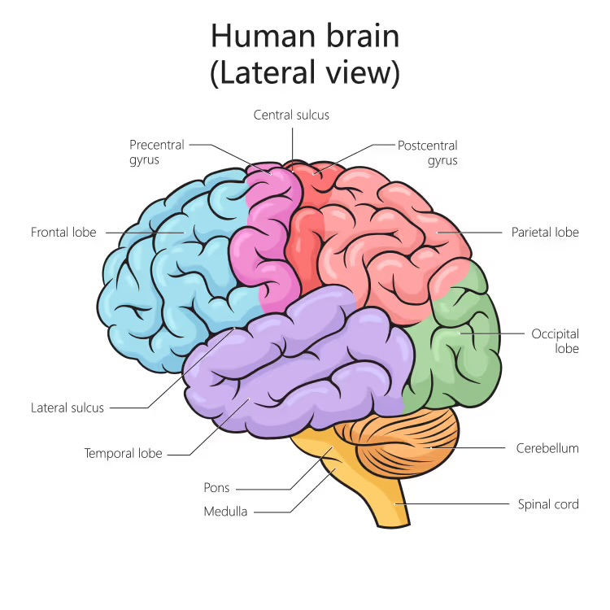
Brain landmarks for orientation
Takeaway: Landmarks help you locate where functions tend to cluster, even though functions rely on networks.
Notes:
Teaching move
- Central sulcus as anchor between motor and somatosensory regions.
Transition
- Use a clear lobe map, then build lobe tendencies.

Slide 25
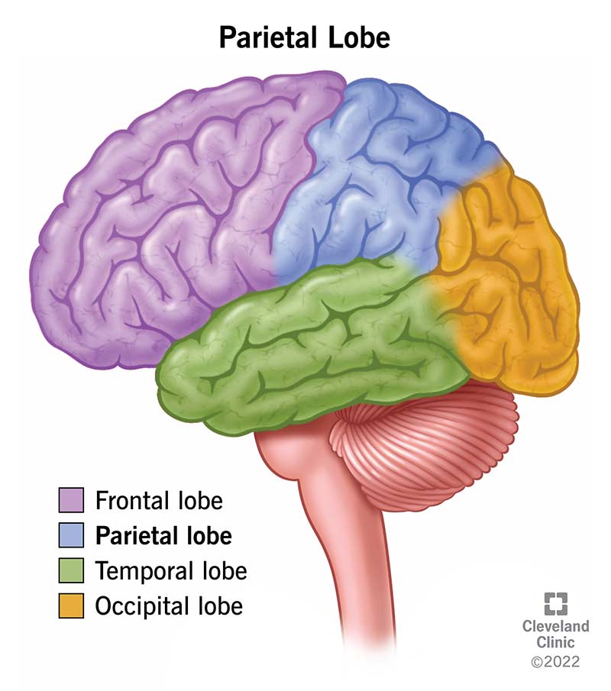
Cerebral cortex lobes
Takeaway: Lobes are a rough map; most functions depend on networks across lobes.
Notes:
Teaching notes
- Use one tendency per lobe in speech, then state the network caution.
Transition
- Engage: apply lobe tendencies to a scenario without overclaiming.

Slide 26
Engage: Which lobe would you check first
For each function, write the lobe you would check first:
Planning and self-control
Touch and body position
Hearing and language comprehension
Visual processing
Two minutes. Write four lobes.
Takeaway: A strong answer gives a reasonable first guess and remembers that networks matter.
Notes:
Intended answers
- Frontal, parietal, temporal, occipital.
Common wrong answers
- Treating first guess as only location.
- Swapping parietal and temporal.
Debrief
- Ask: why is it only a first guess.

Slide 27
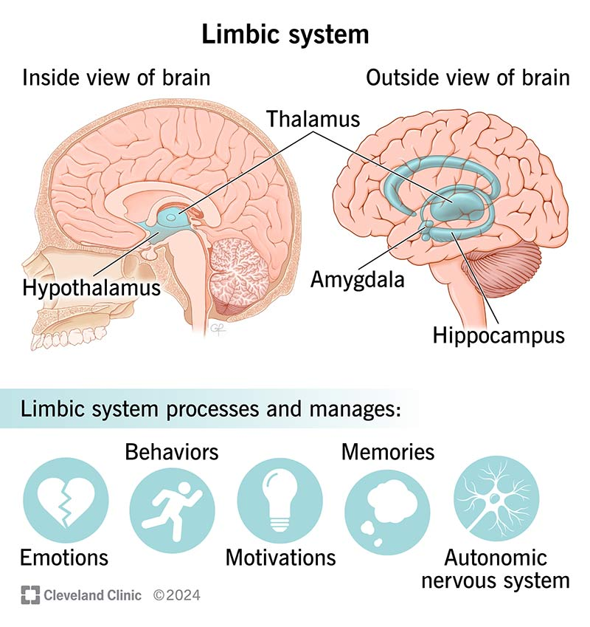
Limbic system overview
Takeaway: Limbic network ideas link emotion, memory, motivation, and body regulation.
Notes:
Accuracy guardrail
- Present as a network concept.
Transition
- Zoom in: amygdala and hippocampus.

Slide 28
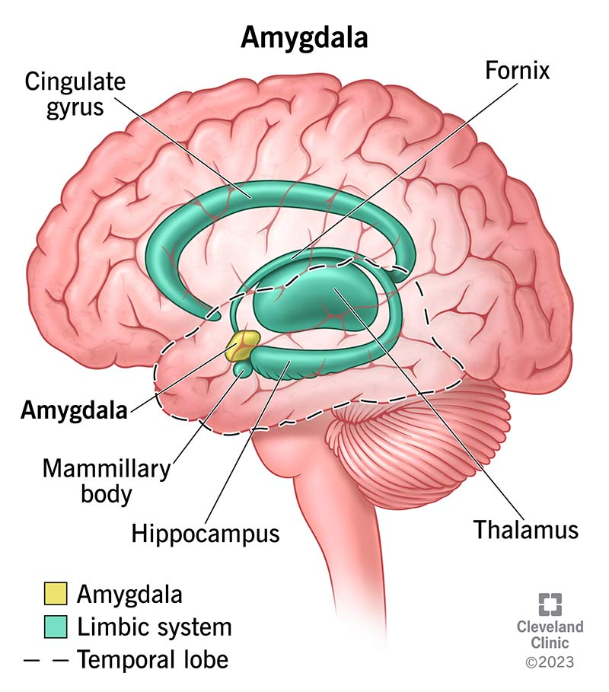
Amygdala in context
Takeaway: The amygdala helps prioritize important stimuli, including potential threats.
Notes:
Accuracy guardrail
- Avoid “amygdala equals fear.”
Transition
- Hippocampus for context and new memory formation.

Slide 29
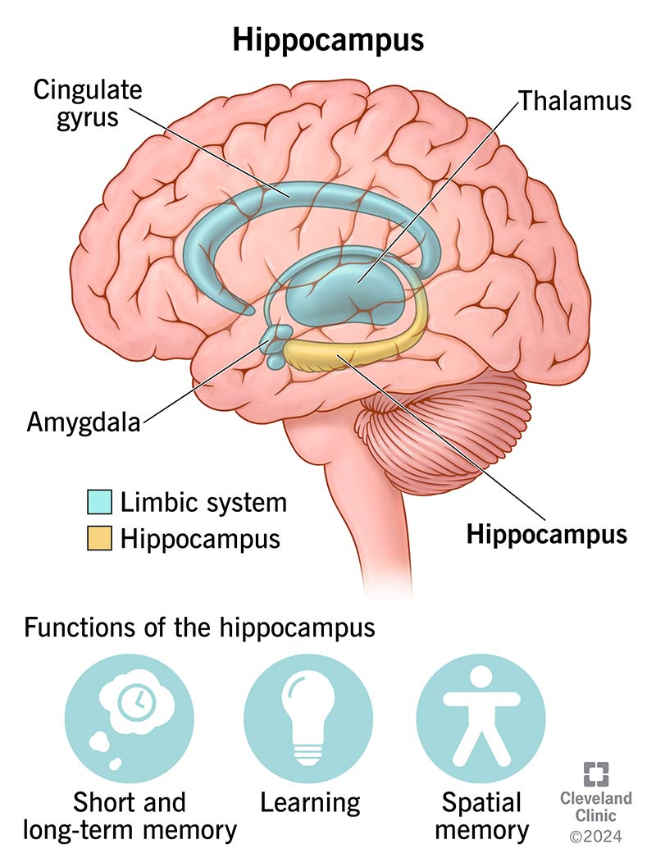
Hippocampus and memory formation
Takeaway: The hippocampus supports forming new episodic memories and linking experiences to context.
Notes:
Accuracy guardrail
- Long-term storage is distributed across cortex.
Transition
- Engage: distinguish roles via a scenario.

Slide 30
Engage: Amygdala and hippocampus together
A student remembers where a scary incident happened and feels fear walking by that spot.
In one sentence, explain how the amygdala and hippocampus could both be involved.
Two minutes. Write one sentence.
Takeaway: A strong answer links context to hippocampus and threat relevance to amygdala.
Notes:
Good answer features
- Mentions context/location or episodic memory as hippocampus-related.
- Mentions salience or threat relevance as amygdala-related.
Common wrong answers
- “Amygdala stores fear memories.” Correct with distributed storage and networks.
Debrief
- Ask for one sentence, then paraphrase precisely.

Slide 31
Methods and limits
Notes:
What is next
- How we study the brain and why method limits matter.
Why this matters
- Prevent treating diagrams or brain images as proof of causation.

Slide 32
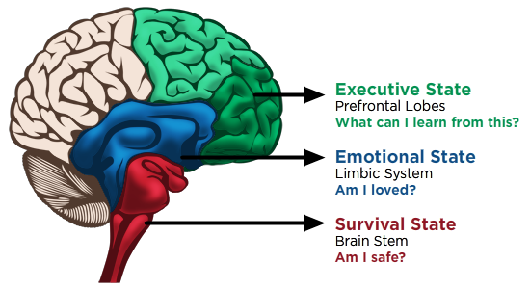
Evaluate an oversimplification
Takeaway: Simple one-region “state” maps are useful metaphors but misleading as anatomy.
Notes:
Use
- Treat this as a misconception check.
What to critique
- Functions are distributed across networks.
- Executive control is not only prefrontal cortex.
Transition
- Name common research methods and what kinds of claims they support.

Slide 33
How we study the brain
Lesions and case studies
EEG and ERPs
fMRI and PET
Stimulation methods
Takeaway: Brain methods trade off timing, location, invasiveness, and causal inference.
Notes:
Key distinctions
- EEG: timing, weaker location.
- fMRI: location, slower and often correlational.
- Lesions and stimulation: closer to causality, but constrained.
Transition
- Engage: what questions to ask before believing a headline.

Slide 34
Engage: What would you ask first
A headline says “This brain region causes anxiety.”
Write one question you would ask before believing it.
Two minutes. Write one sentence.
Takeaway: A strong question asks about method, inference type, and alternative explanations.
Notes:
Good questions
- What method was used.
- Correlational or causal.
- Sample and context.
Debrief
- Collect three questions and group them: method, inference, context.

Slide 35
Plasticity and wrap
Notes:
What is next
- Plasticity as the bridge to learning, memory, development, and disorders.
Why this matters
- Prevent a fixed, destiny-like view of the brain.

Slide 36
Neuroplasticity
Brains change with experience
Connections strengthen and weaken
Development reshapes networks
Injury can reorganize function
Takeaway: Experience changes the brain through plasticity across the lifespan.
Notes:
Guardrails
- Plasticity is real, but not unlimited.
- Timing and constraints matter.
Transition
- Synthesis: connect systems, cells, regions, methods.

Slide 37
Synthesis
Systems map where signals travel
Cells explain how signals happen
Brain regions orient likely function clusters
Methods limit justified conclusions
Takeaway: Neuroscience explains behavior by combining levels of analysis and respecting evidence limits.
Notes:
Teaching move
- Repeat the throughline: map, mechanism, meaning, method.
Transition
- Close with an exit prompt aligned to takeaway-first style.

Slide 38
Exit prompt
Write one takeaway you will remember next week and one question you want answered next class.
Two minutes. Write two lines.
Takeaway: A strong exit response is specific enough to guide study and specific enough to be answerable.
Notes:
Debrief
- Collect a few questions and cluster them: systems, signaling, brain regions, methods.
- Use clusters to decide what to reteach next class.

Slide 39
Resources
In class: Lobe map for quick orientation
In class: Synapse diagram for drug mechanism reasoning
In class: Autonomic branch diagrams for scenario practice
Optional: Practice set on CNS vs PNS and afferent vs efferent
Optional: Short review on action potentials vs synaptic transmission
Takeaway: Use resources to practice explanations, not to memorize labels without meaning.
Notes:
Image licensing reminders
- Several images show Cleveland Clinic watermarks with dates. Verify use rights.
- Several diagrams have no visible source; verify licensing before broad distribution.
In-class workflow
- Keep the in-class list short and use it intentionally.
- If a link fails, use the image already in the deck and narrate accessibly.

